Slide 1
Trabalho prático fundamentos de banco de dados 2018/1

Slide 2
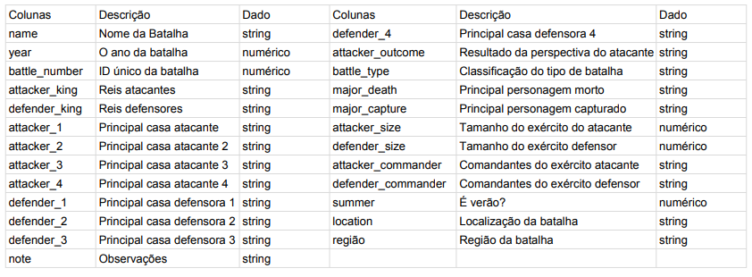
Tabela utilizada
Nome: Batalhas em Game of Thrones

Slide 3
Normalização da tabela
Modelo desnormalizado ÑN
battles(name, year, battle_number, attacker_king, defender_king, attacker_1, attacker_2, attacker_3, attacker_4, defender_1, defender_2, defender_3, defender_4 , attacker_outcome, battle_type, major_death, major_capture, attacker_size, defender_size, attacker_commander, defender_commander, summer, location, region, note)

